Slide 1
PBD of Rigid Body
Chiwell Shao
HC22

Slide 2
Review of basic PBD
Position: p
*********************************************
Extern Force: Gravity, Spring
Damp Velocities: General Momentum Conservation / Free of oscillation
Collision Test: Spatial hash
Solve Constraint: Stretch, Bend, Twist, Volume, Triangle Collisions
Remove Collision Constraint
Velocity Update.
Δp≈-C(p)/(∂C/∂p)/m
ΣΔp*(∂C/∂p)=-C(p)

Slide 3
PBD for rigid body
Position: p,θ
*********************************************
Extern Force: Gravity…
Damp Velocities: General Momentum/Energy Conservation/Friction(Vertical damping)
Collision Test: Spatial hash, GJK/SAT
Solve Constraint: Stretch, Bending, Isometric Bending, Twist, Volume, Collision, Static Friction, Friction
Remove Collision Constraint.
Velocity Update.
Δθ ≈-C(p,θ)/(∂C/∂θ/I

Slide 4
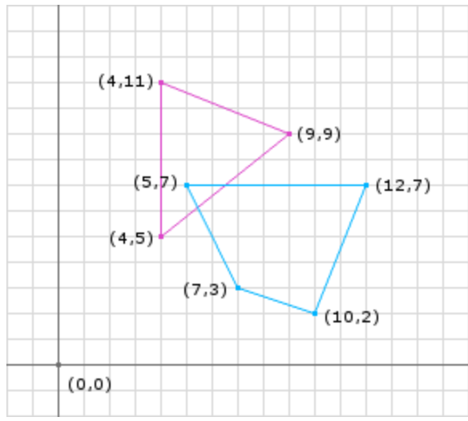
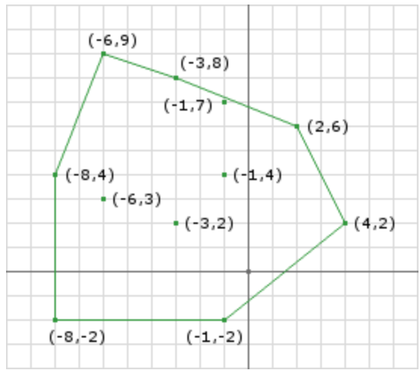
GJK
Minkowski difference
Convex Build
Check Zero point in convex
Get minimum distance

Slide 5
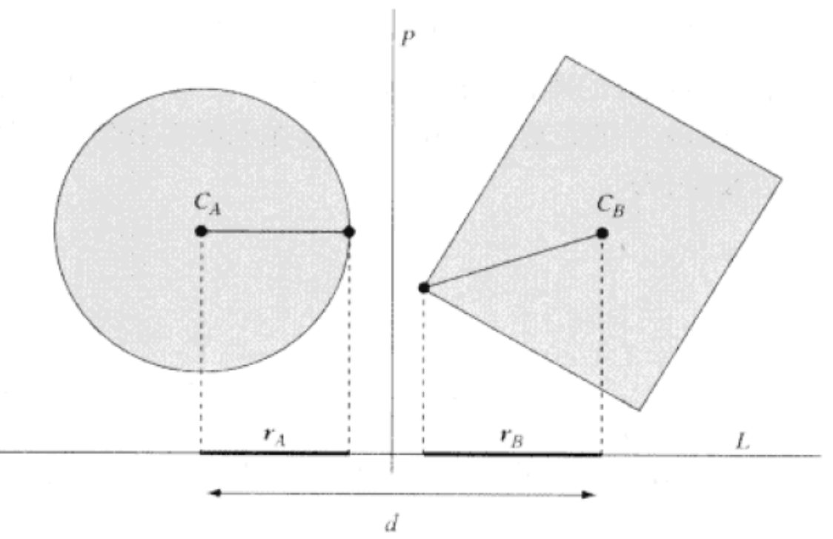
SAT

Slide 6
Collision Cp
Intersection Volume
Intersection Surface
Intersection Depth
General Depth
Local Surface Oriented Depth：C(a, b)=n(a-b)>=0
C’=s*C (s<1.0 for the part C>C0 and s=1.0 for the part C<C0)

Slide 7
dCp
dCp=delta(Cp)/delta(p)

Slide 8
Problems in PBD
Local Energy Conservation
Explicit Euler Solver on external forces
Initial Strain

